Slide 1
Non-parametric density estimation
CS 557 Statistical Pattern Recognition
Mehreen Saeed
September, 2016

Slide 2
ORIGINAL DATA

Slide 3
HISTOGRAM ESTIMATION
h=0.5
h=1
h=10
h=30

Slide 4
NAÏVE ESTIMATE
h=.05
h=1
h=10
h=500
h=70

Slide 5
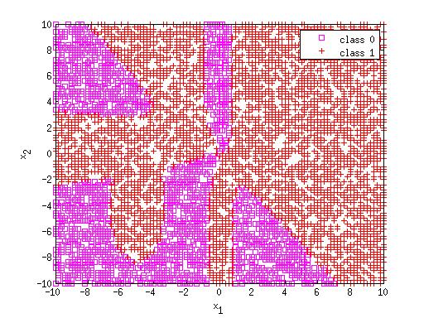
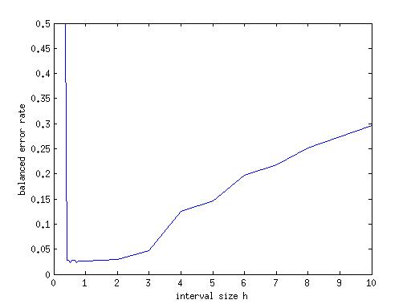
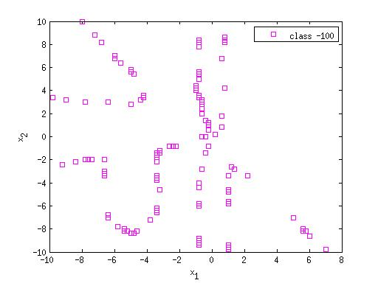
CLASSIFICATION WITH NAIVE DENSITY ESTIMATION
Change of BER with h
The original set of points
Note the non-linear decision boundaries
Error points for h=1

Slide 6
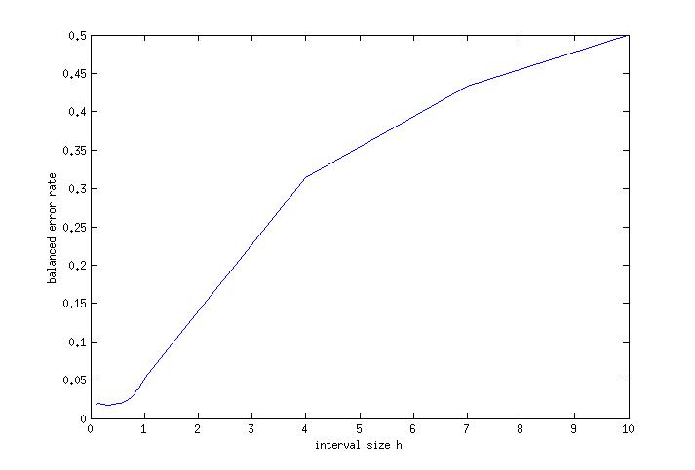
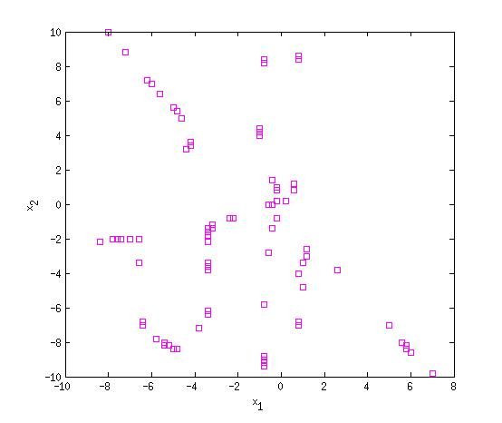
KERNEL ESTIMATE (GAUSSIAN)

Slide 7
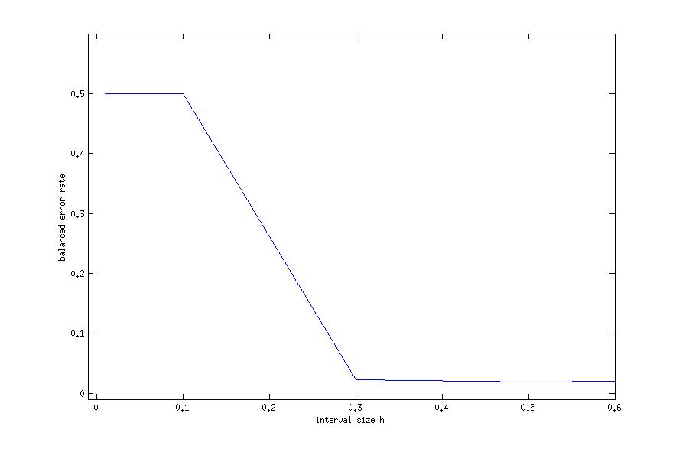
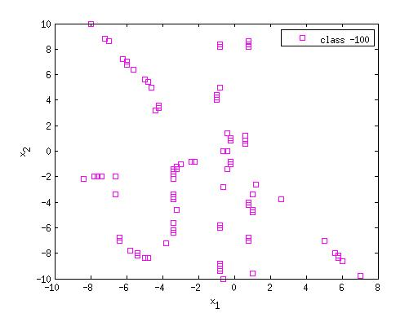
KERNEL ESTIMATE (Epanechnikov)
h BER
0.3000 0.5294
0.5000 0.5440
1.0000 0.5831
3.0000 0.5881
5.0000 0.4790
10.0000 0.2788
20.0000 0.5000

Slide 8
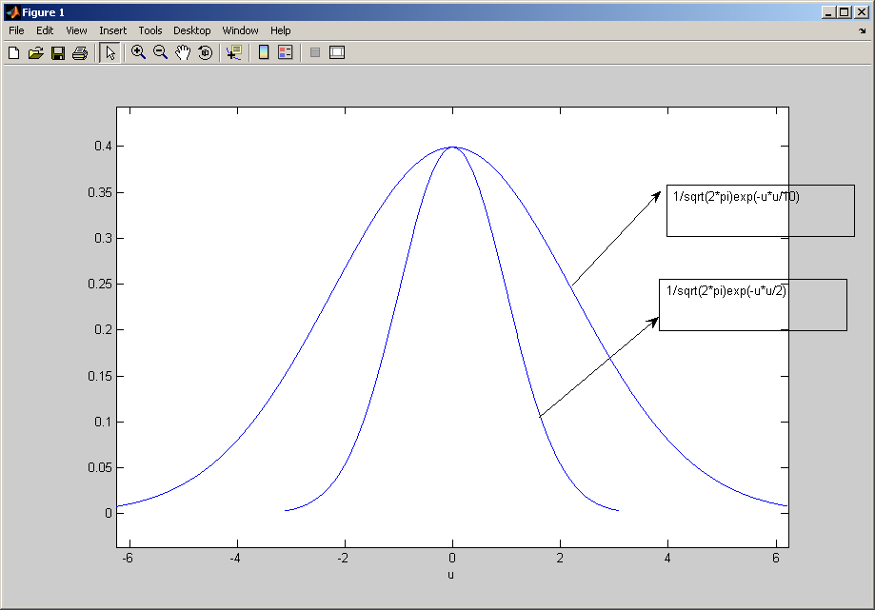
Gaussian Function

Slide 9
DATA, GENERATED BY 2 GAUSSIAN DISTRIBUTIONS

Slide 10
KERNEL ESTIMATE (GAUSSIAN)
h=.01
h=1
h=3
h=15
h=100

Slide 11
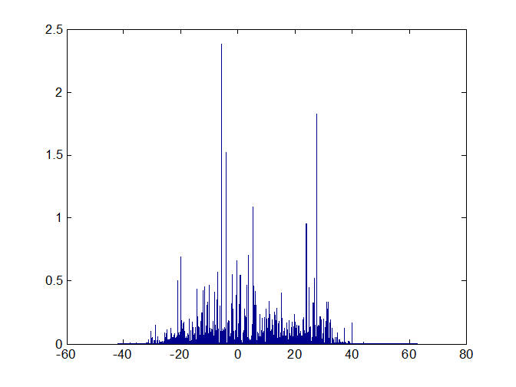
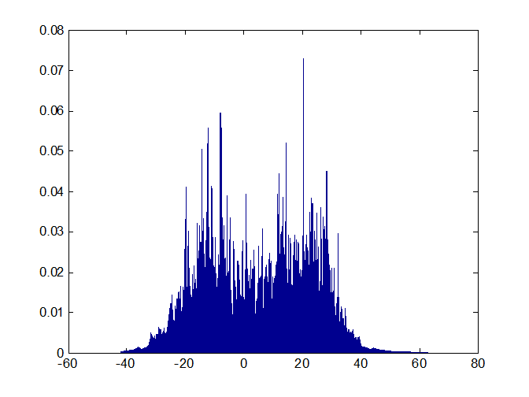
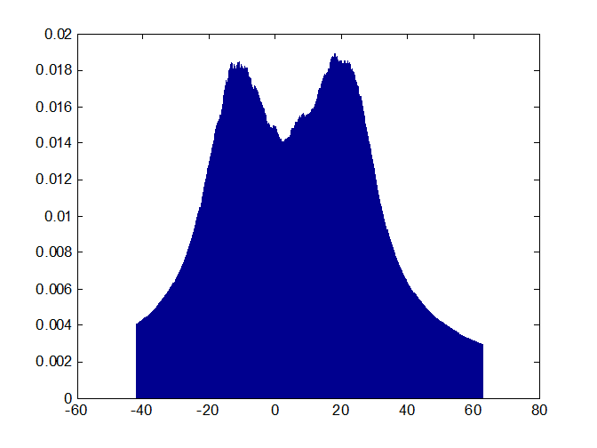
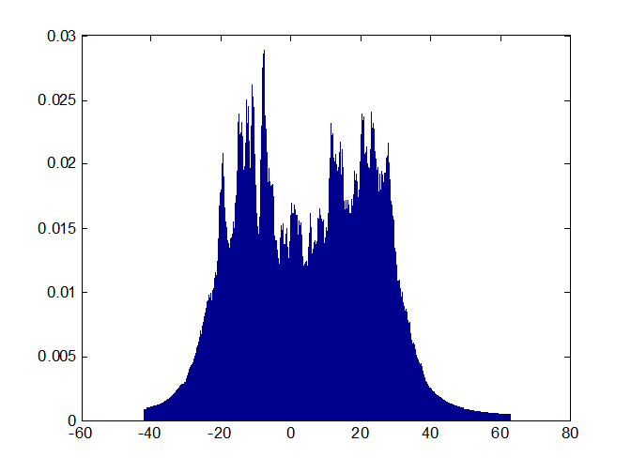
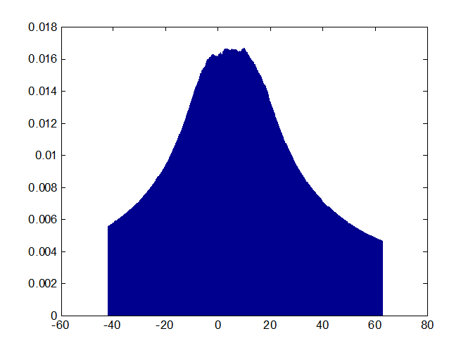
K NEAREST NEIGHBOR DENSITY ESTIMATION
K=3
K=10
K=500
K=1200
K=50

Slide 12
K NEAREST NEIGHBOR DENSITY ESTIMATION
K=3
K=10
K=500
K=1200
K=50

Slide 13
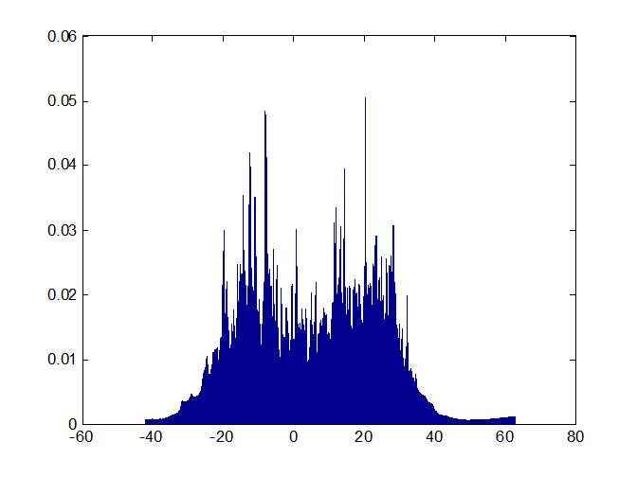
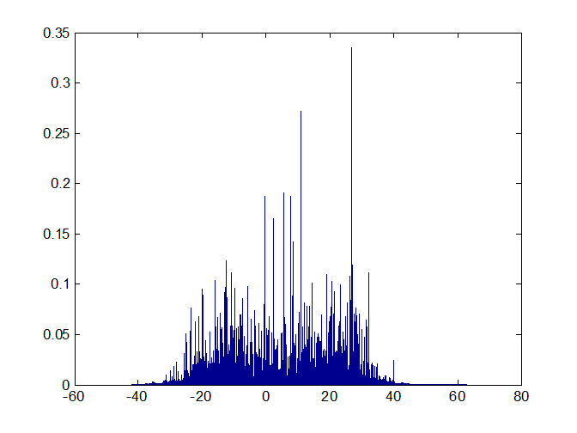
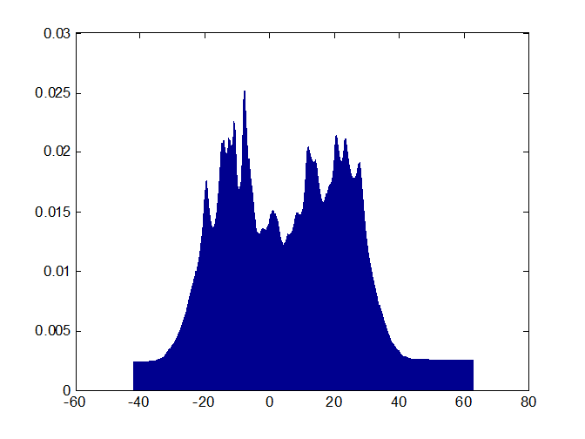
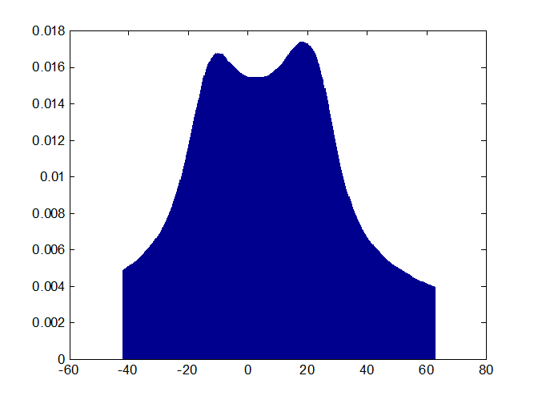
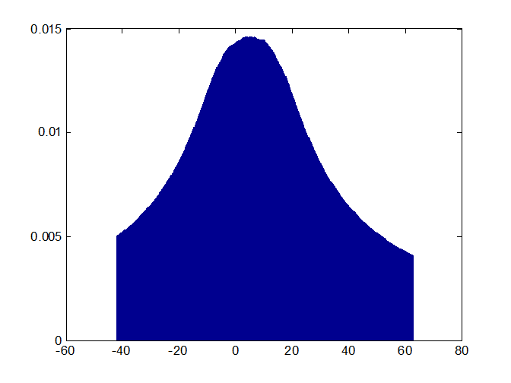
K NEAREST NEIGHBOR SMOOTHED DENSITY ESTIMATION
K=3
K=10
K=500
K=1200
K=50

Slide 14
K-NEAREST NEIGHBOR CLASSIFIER
Errors are marked in magenta
K=11

Slide 15
K-NEAREST NEIGHBOR CLASSIFIER
Errors are marked in magenta
K=1, balanced error rate = 0.0259
K=3, balanced error rate = 0.0193
K=5, balanced error rate = 0.0191
K=11, balanced error rate = 0.0214
K=21, balanced error rate = 0.0206

